Slide 1
Research in Cloud Security and Privacy
--Security and Privacy Issues in Cloud Computing
Portions of this PPT draw from PPTs authored by
Bharat Bhargava, Anya Kim and YounSun Cho

Slide 2
Outline
Part I: Introduction
Part II: Security and Privacy Issues in Cloud Computing
Part III: Possible Solutions

Slide 3
Part III. Possible Solutions
Minimize Lack of Trust
  Policy Language
  Certification
Minimize Loss of Control
  Monitoring
  Utilizing different clouds
  Access control management
  Identity Management (IDM)
Minimize Multi-tenancy

Slide 4
Security Issues in the Cloud
In theory, minimizing any of the issues would help:
  Third Party Cloud Computing
  Loss of Control
    Take back control
      Data and apps may still need to be on the cloud
      But can they be managed in some way by the consumer?
  Lack of trust
    Increase trust (mechanisms)
      Technology
      Policy, regulation
      Contracts (incentives): topic of a future talk
  Multi-tenancy
    Private cloud
      Takes away the reasons to use a cloud in the first place
    VPC: its still not a separate system
    Strong separation
Notes:
While VPC providers argue that they provide superior isolation, the fact of the matter is that your data is not a separate physical system: your data is still stored on actual servers along with other consumers’ data, but logically separated. If the actual server fails, your data and applications stored on it are lost. Also, there needs to be a high level of trust as to the degree of isolation provided.

Slide 5
Known issues: Already exist
Confidentiality issues
Malicious behavior by cloud provider
Known risks exist in any industry practicing outsourcing
Provider and its infrastructure needs to be trusted

Slide 6
New Vulnerabilities & Attacks
Threats arise from other consumers
Due to the subtleties of how physical resources can be transparently shared between VMs
Such attacks are based on placement and extraction
A customer VM and its adversary can be assigned to the same physical server
Adversary can penetrate the VM and violate customer confidentiality

Slide 7
More on attacks…
Collaborative attacks
Mapping of internal cloud infrastructure
Identifying likely residence of a target VM
Instantiating new VMs until one gets co-resident with the target
Cross-VM side-channel attacks
Extract information from target VM on the same machine

Slide 8
More on attacks…
Can one determine where in the cloud infrastructure an instance is located?
Can one easily determine if two instances are co-resident on the same physical machine?
Can an adversary launch instances that will be co-resident with other user instances?
Can an adversary exploit cross-VM information leakage once co-resident?
Answer: Yes to all

Slide 9
- POLICY LANGUAGE
- CERTIFICATION
Minimize Lack of Trust

Slide 10
Minimize Lack of Trust: Policy Language
Consumers have specific security needs but don’t have a say-so in how they are handled
  What the heck is the provider doing for me?
  Currently consumers cannot dictate their requirements to the provider (SLAs are one-sided)
Standard language to convey one’s policies and expectations
  Agreed upon and upheld by both parties
  Standard language for representing SLAs
  Can be used in a intra-cloud environment to realize overarching security posture
Notes:
These SLAs typically state the high level policies of the provider (e.g. Will maintain uptime of 98%) and do not allow cloud consumers to dictate their requirements to the provider. COI clouds in particular have specific security policy requirements that must be met by the provider, due to the nature of COIs and the missions they are used for. These requirements need to be communicated to the provider and the provider needs to provide some way of stating that the requirements can be met. Cloud consumers and providers need a standard way of representing their security requirements and capabilities. Consumers also need a way to verify that the provided infrastructure and its purported security mechanisms meet the requirements stated in the consumer’s policy (proof of assertions). For example, if the consumer’s policy requires isolation of VMs, the provider can create an assertion statement that says it uses cache separation to support VM isolation.

Slide 11
Minimize Lack of Trust: Policy Language (Cont.)
Create policy language with the following characteristics:
  Machine-understandable (or at least processable),
  Easy to combine/merge and compare
  Examples of policy statements are, “requires isolation between VMs”, “requires geographical isolation between VMs”, “requires physical separation between other communities/tenants that are in the same industry,” etc.
  Need a validation tool to check that the policy created in the standard language correctly reflects the policy creator’s intentions (i.e. that the policy language is semantically equivalent to the user’s intentions).

Slide 12
Minimize Lack of Trust: Certification
Certification
  Some form of reputable, independent, comparable assessment and description of security features and assurance
  Sarbanes-Oxley, DIACAP, DISTCAP, etc (are they sufficient for a cloud environment?)
Risk assessment
  Performed by certified third parties
  Provides consumers with additional assurance

Slide 13
- MONITORING
- UTILIZING DIFFERENT CLOUDS
- ACCESS CONTROL MANAGEMENT
- IDENTITY MANAGEMENT (IDM)
Minimize Loss of Control

Slide 14
Minimize Loss of Control: Monitoring
Cloud consumer needs situational awareness for critical applications
  When underlying components fail, what is the effect of the failure to the mission logic
  What recovery measures can be taken (by provider and consumer)
Requires an application-specific run-time monitoring and management tool for the consumer
  The cloud consumer and cloud provider have different views of the system
  Enable both the provider and tenants to monitor the components in the cloud that are under their control
Notes:
When the underlying components fail in the cloud, the effect of the failures to the mission logic needs to be known so that correct recovery measures can be performed. We propose an application-specific run-time monitoring and management tool. With this tool, the application logic can remain on the consumer’s host computer. This allows the consumer to centrally monitor all aspects of the application as well as data flow. Since all outputs from underlying services are sent to the application logic, any data incompatibility between services is not an issue. The capabilities of the run-time monitoring and management tool are as follows: 1) Enable application user to determine the status of the cloud resources that may be used to run the application (across multiple clouds), 2) Enable application user to determine the real-time security posture and situational awareness of the application, 3) Provide the application user with the ability to move user’s application (or part of it) to another site (other VM in same cloud or different cloud altogether), 4) Provide the application user with the ability to change the application logic on the fly, 5) Provide communicate capabilities with cloud providers. There are a few cloud vendors such as NimSoft [41] and Hyperic [42] that provide application-specific monitoring tools that provide some of the above functionality. These monitoring tools may be further enhanced or used in conjunction with other tools to provide the degree of monitoring required. However, any tool that is to be used for military purposes must also receive some type of accreditation and certification procedure.

Slide 15
Minimize Loss of Control: Monitoring (Cont.)
  Provide mechanisms that enable the provider to act on attacks he can handle.
    infrastructure remapping (create new or move existing fault domains)
    shutting down offending components or targets (and assisting tenants with porting if necessary
    Repairs
  Provide mechanisms that enable the consumer to act on attacks that he can handle (application-level monitoring).
    RAdAC (Risk-adaptable Access Control)
    VM porting with remote attestation of target physical host
    Provide ability to move the user’s application to another cloud

Slide 16
Minimize Loss of Control: Utilize Different Clouds
The concept of ‘Don’t put all your eggs in one basket’
  Consumer may use services from different clouds through an intra-cloud or multi-cloud architecture
  Propose a multi-cloud or intra-cloud architecture in which consumers
    Spread the risk
    Increase redundancy (per-task or per-application)
    Increase chance of mission completion for critical applications
  Possible issues to consider:
    Policy incompatibility (combined, what is the overarching policy?)
    Data dependency between clouds
    Differing data semantics across clouds
    Knowing when to utilize the redundancy feature (monitoring technology)
    Is it worth it to spread your sensitive data across multiple clouds?
      Redundancy could increase risk of exposure
Notes:
Differering data semantics example: does a data item labeled secret in one cloud have the same semantics as another piece of data also labeled secret in a different cloud?

Slide 17
Minimize Loss of Control: Access Control
Many possible layers of access control
  E.g. access to the cloud, access to servers, access to services, access to databases (direct and queries via web services), access to VMs, and access to objects within a VM
  Depending on the deployment model used, some of these will be controlled by the provider and others by the consumer
Regardless of deployment model, provider needs to manage the user authentication and access control procedures (to the cloud)
  Federated Identity Management: access control management burden still lies with the provider
  Requires user to place a large amount of trust on the provider in terms of security, management, and maintenance of access control policies. This can be burdensome when numerous users from different organizations with different access control policies, are involved
Notes:
In cloud computing (as well as other systems), there are many possible layers of access control. For example, access to the cloud, access to servers, access to services, access to databases (direct and queries via web services), access to VMs, and access to objects within a VM. Depending on the deployment model used, some of these will be controlled by the provider and others by the consumer.
For example, Google Apps, a representative SaaS Cloud controls authentication and access to its applications, but users themselves can control access to their documents through the provided interface to the access control mechanism. In IaaS type approaches, the user can create accounts on its virtual machines and create access control lists for these users for services located on the VM.
Regardless of the deployment model, the provider needs to manage the user authentication and access control procedures (to the cloud). While some providers allow federated authentication – enabling the consumer-side to manage its users, the access control management burden still lies with the provider. This requires the user to place a large amount of trust on the provider in terms of security, management, and maintenance of access control policies. This can be burdensome when numerous users from different organizations with different access control policies, are involved. This proposal focuses on access control to the cloud. However, the concepts here could be applied to access control at any level, if deemed necessary. We propose a way for the consumer to manage the access control decision-making process to retain some control, requiring less trust of the provider.
Approach:
This approach requires the client and provider to have a pre-existing trust relationship, as well as a pre-negotiated standard way of describing resources, users, and access decisions between the cloud provider and consumer. It also needs to be able to guarantee that the provider will uphold the consumer-side’s access decisions. Furthermore, we need to show that this approach is at least as secure as the traditional access control model.
This approach requires the data owner to be involved in all requests. Therefore, frequent access scenarios should not use this method if traffic is a concern. However, many secure data outsourcing schemes require the user to grant keys/certificates to the query side, so that every time the user queries a database, the owner needs to be involved. Therefore, not much different than that so may not be a problem.

Slide 18
Minimize Loss of Control: Access Control (Cont.)
Consumer-managed access control
  Consumer retains decision-making process to retain some control, requiring less trust of the provider (i.e. PDP is in consumer’s domain)
  Requires the client and provider to have a pre-existing trust relationship, as well as a pre-negotiated standard way of describing resources, users, and access decisions between the cloud provider and consumer. It also needs to be able to guarantee that the provider will uphold the consumer-side’s access decisions.
  Should be at least as secure as the traditional access control model.
  Facebook and Google Apps do this to some degree, but not enough control
  Applicability to privacy of patient health records

Slide 19

Minimize Loss of Control: Access Control
Cloud Provider in Domain A
Cloud Consumer in Domain B
1. Authn request
IDP
PEP
(intercepts all
resource
access requests
from all client
domains)
3. Resource request (XACML Request) + SAML assertion
2. SAML Assertion
.
.
.
4. Redirect to domain of resource owner
PDP
for cloud
resource
on Domain A
5. Retrieve policy
for specified resource
resources
ACM
(XACML
policies)
7. Send signed and encrypted ticket
6. Determine whether user can access
specified resource
7. Create ticket for grant/deny
8. Decrypt and verify signature
9. Retrieve capability from ticket
10. Grant or deny access based on capability

Slide 20



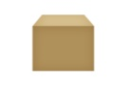

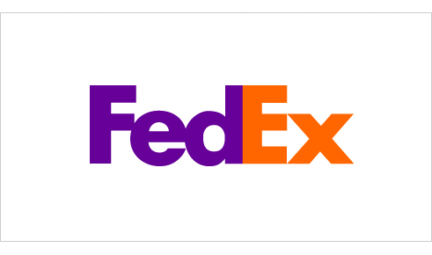
Minimize Loss of Control: IDM Motivation
User on Amazon Cloud
Name
E-mail
Password
Billing Address
Shipping Address
Credit Card
Name
Billing Address
Credit Card
Name
E-mail
Password
Billing Address
Shipping Address
Credit Card
Name
E-mail
Shipping Address
Name
E-mail
Shipping Address

Slide 21
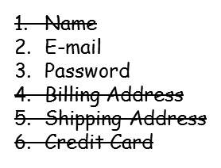
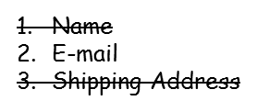
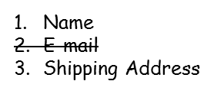
Minimize Loss of Control: IDM Identity in the Cloud
User on Amazon Cloud
Name
Billing Address
Credit Card
Name
E-mail
Password
Billing Address
Shipping Address
Credit Card

Slide 22
Minimize Loss of Control: IDM Present IDMs
IDM in traditional application-centric IDM model
  Each application keeps track of identifying information of its users.
Existing IDM Systems
  Microsoft Windows CardSpace [W. A. Alrodhan]
  OpenID [http://openid.net]
  PRIME [S. F. Hubner]
These systems require a trusted third party and
do not work on an untrusted host.
If Trusted Third Party is compromised, all the identifying information of the users is also compromised
[Latest: AT&T iPad leak]

Slide 23
Minimize Loss of Control: IDM Issues in Cloud Computing
Cloud introduces several issues to IDM
  Users have multiple accounts associated with multiple service providers.
  Lack of trust
    Use of Trusted Third Party is not an option
    Cloud hosts are untrusted
  Loss of control
    Collusion between Cloud Services
      Sharing sensitive identity information between services can lead to undesirable mapping of the identities to the user.
IDM in Cloud needs to be user-centric

Slide 24
Minimize Loss of Control: IDM
Goals of Proposed User-Centric IDM for the Cloud
Authenticate without disclosing identifying information
Ability to securely use a service while on an untrusted host (VM on the cloud)
Minimal disclosure and minimized risk of disclosure during communication between user and service provider (Man in the Middle, Side Channel and Correlation Attacks)
Independence of Trusted Third Party

Slide 25
Minimize Loss of Control: IDM Approach - 1
IDM Wallet:
  Use of AB scheme to protect PII from untrusted hosts.
Anonymous Identification:
  Use of Zero-knowledge proofing for authentication of an entity without disclosing its identifier.

Slide 26
Minimize Loss of Control: IDM
Components of Active Bundle (Approach – 1)
Identity data: Data used during authentication, getting service, using service (i.e. SSN, Date of Birth).
Disclosure policy: A set of rules for choosing Identity data from a set of identities in IDM Wallet.
Disclosure history: Used for logging and auditing purposes.
Negotiation policy: This is Anonymous Identification, based on the Zero Knowledge Proofing.
Virtual Machine: Code for protecting data on untrusted hosts. It enforces the disclosure policies.

Slide 27
Minimize Loss of Control: IDM
Anonymous Identification (Approach – 1)
Anonymous Identification
(Shamir's approach for Credit Cards)
IdP provides Encrypted Identity Information to the user and SP.
SP and User interact
Both run IdP's public function on the certain bits of the Encrypted data.
Both exchange results and agree if it matches.

Slide 28
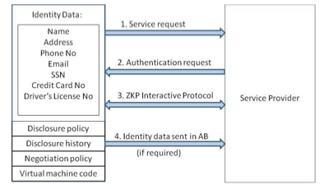
Minimize Loss of Control: IDM
Usage Scenario (Approach – 1)

Slide 29
Minimize Loss of Control: IDM Approach - 2
Active Bundle scheme to protect PII from untrusted hosts
Predicates over encrypted data to authenticate without disclosing unencrypted identity data.
Multi-party computing to be independent of a trusted third party

Slide 30
Minimize Loss of Control: IDM Usage Scenario
(Approach – 2)
Owner O encrypts Identity Data(PII) using algorithm Encrypt and O’s public key PK. Encrypt outputs CT—the encrypted PII.
SP transforms his request for PII to a predicate represented by function p.
SP sends shares of p to the n parties who hold the shares of MSK.
n parties execute together KeyGen using PK, MSK, and p, and return TKp to SP.
SP calls the algorithm Query that takes as input PK, CT, TKp and produces p(PII) which is the evaluation of the predicate.
The owner O is allowed to use the service only when the predicate evaluates to “true”.

Slide 31
Minimize Loss of Control: IDM
Representation of identity information for negotiation
  Token/Pseudonym
  Identity Information in clear plain text
  Active Bundle

Slide 32
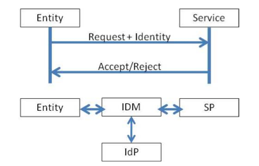
Minimize Loss of Control: IDM
Motivation-Authentication Process using PII
Problem: Which information to disclose and how to disclose it.

Slide 33
Proposed IDM: Mechanisms
[16] Protection of Identity Information in Cloud Computing without Trusted Third Party - R. Ranchal, B. Bhargava, L.B. Othmane, L. Lilien, A. Kim, M. Kang, Third International Workshop on Dependable Network Computing and Mobile Systems (DNCMS) in conjunction with 29th IEEE Symposium on Reliable Distributed System (SRDS) 2010
[17] A User-Centric Approach for Privacy and Identity Management in Cloud Computing - P. Angin, B. Bhargava, R. Ranchal, N. Singh, L. Lilien, L.B. Othmane 29th IEEE Symposium on Reliable Distributed System (SRDS) 2010
Privacy in Cloud Computing Through Identity Management - B. Bhargava, N. Singh, A. Sinclair, International Conference on Advances in Computing and Communication ICACC-11, April, 2011, India.
Active Bundle
Anonymous Identification
Computing Predicates with encrypted data
Multi-Party Computing
Selective Disclosure

Slide 34
Proposed IDM: Active Bundle
Active bundle (AB)
  An encapsulating mechanism protecting data carried within it
  Includes data
  Includes metadata used for managing confidentiality
    Both privacy of data and privacy of the whole AB
  Includes Virtual Machine (VM)
    performing a set of operations
    protecting its confidentiality

Slide 35
Proposed IDM: Active Bundle (Cont.)
Active Bundles—Operations
  Self-Integrity check
    E.g., Uses a hash function
  Evaporation/ Filtering
  Self-destroys (a part of) AB’s sensitive data when threatened with a disclosure
  Apoptosis
  Self-destructs AB’s completely

Slide 36
Proposed IDM: Active Bundle Scheme
  Metadata:
    Access control policies
    Data integrity checks
    Dissemination policies
    Life duration
    ID of a trust server
    ID of a security server
    App-dependent information
    …
E(Name)
E(E-mail)
E(Password)
E(Shipping Address)
E(Billing Address)
E(Credit Card)
…
  Sensitive Data:
    Identity Information
    ...
  Virtual Machine (algorithm):
    Interprets metadata
    Checks active bundle integrity
    Enforces access and dissemination control policies
    …
* E( ) - Encrypted Information

Slide 37
Proposed IDM: Anonymous Identification
  Use of Zero-knowledge proofing for user authentication without disclosing its identifier.
User on Amazon Cloud
ZKP Interactive Protocol
User Request for service
Function f and number k
E-mail
Password
f_{k}(E-mail, Password) = R
E-mail
Password
Authenticated

Slide 38








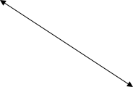





Proposed IDM: Interaction using Active Bundle
AB information disclosure
Active Bundle Destination
User Application
Active Bundle
Active Bundle Creator
Active
Bundle (AB)
Security Services
Agent (SSA)
Audit Services
Agent (ASA)
Directory
Facilitator
Trust Evaluation
Agent (TEA)
Active Bundle Coordinator
Active Bundle Services

Slide 39
Proposed IDM: Predicate over Encrypted Data
  Verification without disclosing unencrypted identity data.
Predicate Request*
E-mail
Password
E(Name)
E(Shipping Address)
E(Billing Address)
E(Credit Card)
E(Name)
E(Billing Address)
E(Credit Card)
  *Age Verification Request
  *Credit Card Verification Request

Slide 40
Proposed IDM: Multi-Party Computing
  To become independent of a trusted third party
    Multiple Services hold shares of the secret key
    Minimize the risk
Predicate Request
E(Name)
E(Billing Address)
E(Credit Card)
K’₁
K’₂
K’₃
K’_{n}
Key Management Services
  * Decryption of information is handled by the Key Management services

Slide 41
Proposed IDM: Multi-Party Computing
  To become independent of a trusted third party
    Multiple Services hold shares of the secret key
    Minimize the risk
Predicate Reply*
Name
Billing Address
Credit Card
K’₁
K’₂
K’₃
K’_{n}
Key Management Services
  *Age Verified
  *Credit Card Verified

Slide 42
Proposed IDM: Selective Disclosure
  User Policies in the Active Bundle dictate dissemination
Selective disclosure*
E-mail
Password
E(Name)
E(Shipping Address)
E(Billing Address)
E(Credit Card)
E(E-mail)
E(Name)
E(Shipping Address)
*e-bay shares the encrypted information based on the user policy

Slide 43
Proposed IDM: Selective Disclosure
  User Policies in the Active Bundle dictate dissemination
Selective disclosure*
E-mail
Password
E(Name)
E(Shipping Address)
E(Billing Address)
E(Credit Card)
E-mail
E(Name)
E(Shipping Address)
Decryption handled by Multi-Party Computing as in the previous slides

Slide 44
Proposed IDM: Selective Disclosure
Selective disclosure*
E-mail
E(Name)
E(Shipping Address)
E(Name)
E(Shipping Address)
*e-bay seller shares the encrypted information based on the user policy

Slide 45
Proposed IDM: Selective Disclosure
Selective disclosure
E-mail
E(Name)
E(Shipping Address)
Name
Shipping Address
  Decryption handled by Multi-Party Computing as in the previous slides

Slide 46


Proposed IDM: Selective Disclosure
Selective disclosure
E-mail
E(Name)
E(Shipping Address)
Name
Shipping Address
  Fed-Ex can now send the package to the user

Slide 47
Proposed IDM: Identity in the Cloud
User on Amazon Cloud
E-mail
Password
Name
Billing Address
Credit Card
Name
E-mail
Password
Billing Address
Shipping Address
Credit Card
E-mail
Name
Shipping Address

Slide 48
Proposed IDM: Characteristics and Advantages
Ability to use Identity data on untrusted hosts
  Self Integrity Check
  Integrity compromised- apoptosis or evaporation
  Data should not be on this host
Independent of Third Party
  Prevents correlation attacks
Establishes the trust of users in IDM
  Through putting the user in control of who has his data
  Identity is being used in the process of authentication, negotiation, and data exchange.
Minimal disclosure to the SP
  SP receives only necessary information.

Slide 49
Proposed IDM: Conclusion & Future Work
Problems with IDM in Cloud Computing
  Collusion of Identity Information
  Prohibited Untrusted Hosts
  Usage of Trusted Third Party
Proposed Approaches
  IDM based on Anonymous Identification
  IDM based on Predicate over Encrypted data
Future work
  Develop the prototype, conduct experiments and evaluate the approach

Slide 50
Minimize Multi-tenancy

Slide 51
Minimize Multi-tenancy
Can’t really force the provider to accept less tenants
  Can try to increase isolation between tenants
    Strong isolation techniques (VPC to some degree)
      C.f. VM Side channel attacks (T. Ristenpart et al.)
    QoS requirements need to be met
    Policy specification
  Can try to increase trust in the tenants
    Who’s the insider, where’s the security boundary? Who can I trust?
    Use SLAs to enforce trusted behavior

Slide 52
Conclusion
Cloud computing is sometimes viewed as a reincarnation of the classic mainframe client-server model
  However, resources are ubiquitous, scalable, highly virtualized
  Contains all the traditional threats, as well as new ones
In developing solutions to cloud computing security issues it may be helpful to identify the problems and approaches in terms of
  Loss of control
  Lack of trust
  Multi-tenancy problems

Slide 53
Identity-Based Authentication for Cloud Computing
Hongwei Li, Yuanshun Dai, Ling Tian, and Haomiao Yang
CloudCom ‘09

Slide 54
What did they do?
Proposed identity-based authentication for cloud computing, based on the identity-based hierarchical model for cloud computing (IBHMCC) and corresponding encryption and signature schemes
Being certificate-free, the authentication protocol aligned well with demands of cloud computing

Slide 55
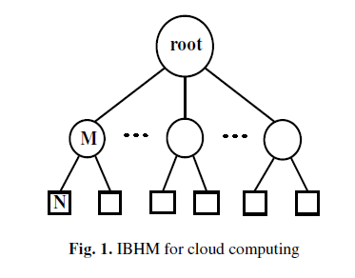
Identity-Based Hierarchical Model for
Cloud Computing (IBHMCC)
Define the identity of node is the DN string from the root node to the current node itself.
The identity of entity N is
ID_N = DN_0 || DN_M || DN_N

Slide 56
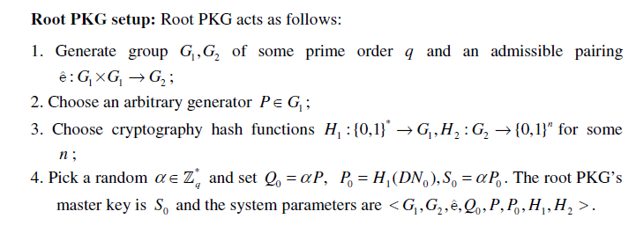
Deployment of IBHMCC
Root PKG setup and Low-level setup

Slide 57
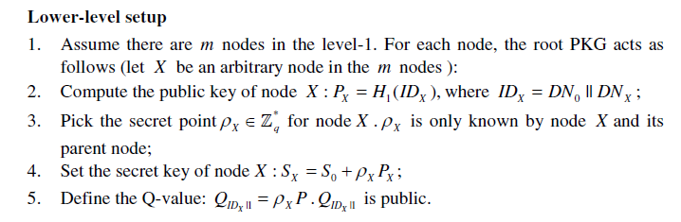
Deployment of IBHMCC (cont.)
After that, all nodes in the level-1 get and securely keep their secret keys and the secret points.
The public key and the Q-value are publicized.
Then, Each node in the level-1 similarly repeats the above steps (2-5).

Slide 58
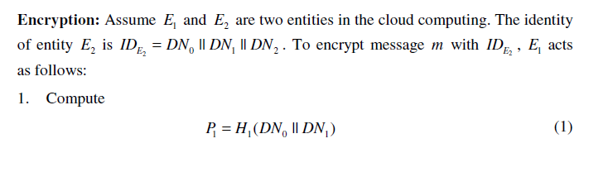
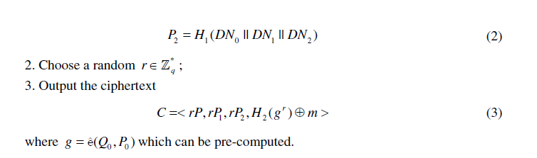
Identity-Based Encryption

Slide 59
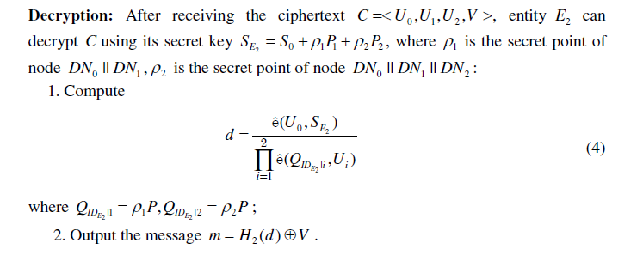
Identity-Based Encryption (cont.)

Slide 60
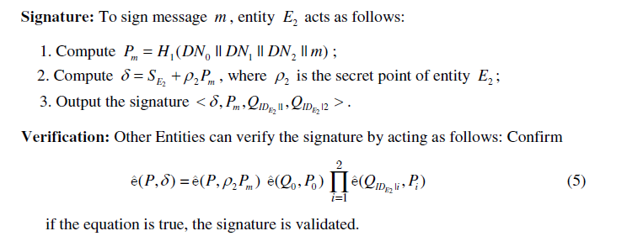
Identity-Based Signature

Slide 61
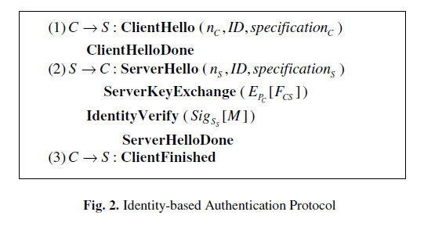
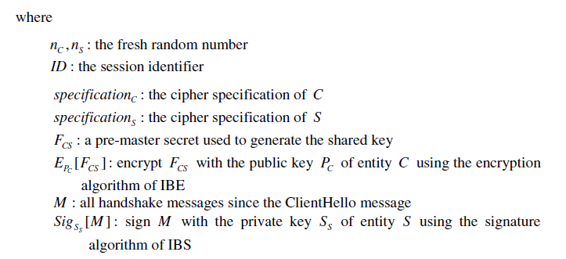
Identity-Based Authentication for Cloud Computing
Extends from TLS to handle the IBE and IBS schemes

Slide 62
A Simple Technique for Securing Data at Rest Stored in a Computing Cloud
Jeff Sedayao, Steven Su, Xiaohao Ma, Minghao Jiang, and Kai Miao
CloudCom ’09

Slide 63
What did they do?
Simple technique implemented with Open Source software solves the confidentiality of data stored on Cloud Computing Infrastructure by using public key encryption to render stored data at rest unreadable by unauthorized personnel, including system administrators of the cloud computing service on which the data is stored
Validated their approach on a network measurement system implemented on PlanetLab
Used it on a service where confidentiality is critical – a scanning application that validates external firewall implementations

Slide 64
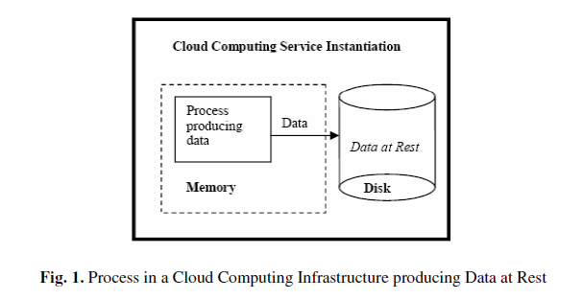
Problem Scope
Goal is to ensure the confidentiality of data at rest
“Data at rest” means that the data that is stored in a readable form on a Cloud Computing service, whether in a storage product like S3 or in a virtual machine instance as in EC2

Slide 65
Problem Scope (cont.)
To protect data at rest, they want to prevent other users in the cloud infrastructure who might have access to the same storage from reading the data our process has stored
They also want to prevent system administrators who run the cloud computing service from reading the data.
They assume that it is unlikely for an adversary to snoop on the contents of memory.
  If the adversary had that capability, it is unlikely that we could trust the confidentiality of any of the data that we generated there.

Slide 66
Problem Scope (cont.)
While the administrative staff of the cloud computing service could theoretically monitor the data moving in memory before it is stored in disk, we believe that administrative and legal controls should prevent this from happening.
They also do not guard against the modification of the data at rest, although we are likely to be able to detect this.

Slide 67
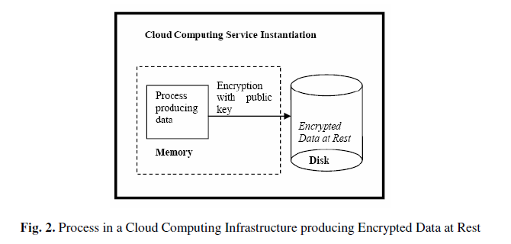
Solution Design

Slide 68
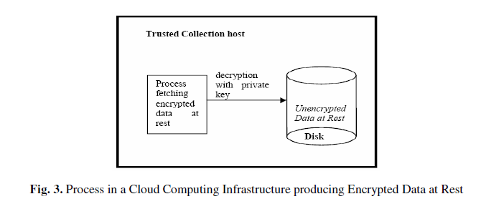
Solution Design (cont.)
On a trusted host, collect the encrypted data, as shown in Figure 3, and decrypt it with the collection agent’s private key which stays on that host. Note that in this case, we are in exclusive control of the private key, which the cloud service provider has no view or control over.
They will discuss this feature of our solution later.

Slide 69
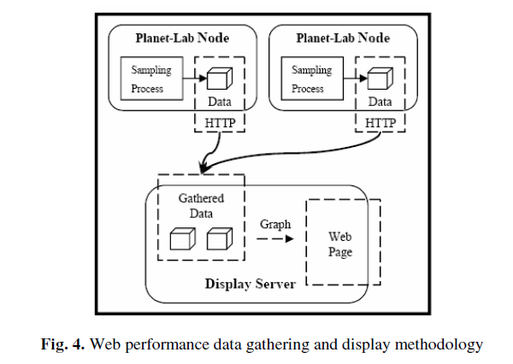
Implementation Experiences

Slide 70
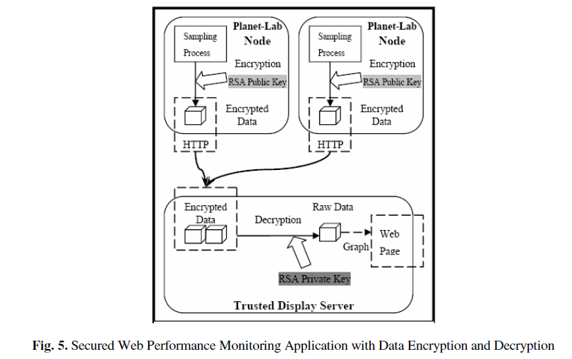
Implementation Experiences (cont.)

Slide 71
Privacy in a Semantic Cloud:
What’s Trust Got to Do with It?
Åsmund Ahlmann Nyre and Martin Gilje Jaatun
CloudCom’09

Slide 72
What did they do?
A brief survey on recent work on privacy and trust for the semantic web, and sketch a middleware solution for privacy protection that leverages probabilistic methods for automated trust and privacy management for the semantic web

Slide 73
Trust Management
Definition of trust
  The willingness of a party to be vulnerable to the actions of another party based on the expectation that the other will perform a particular action important to the trustor, irrespective of the ability to monitor and control that other party.

Slide 74
Trust Management (cont.)
Trust Models
  Mayer, R., Davis, J., Schoorman, F.: An integrative model of organizational trust. Academy of Management Review
    The main factors of trustworthiness were identified as ability, benevolence and integrity.
    On the trustor’s part, disposition to trust and perceived risk were identified as the most influential factors with regards to trust.
    Furthermore, the outcome of a trust relation (experience) is assumed to influence one or more of the trustworthiness factors and hence the trustworthiness of the trustee.

Slide 75
Trust Management (cont.)
Trust Models
  The complexity of several proposed models does not necessarily give better trust assessments
  Conrad, M., French, T., Huang, W., Maple, C.: A lightweight model of trust propagation in a multi-client network environment: to what extent does experience matter?
    Proposed a lightweight model for trust propagation. The parameters self confidence, experience, hearsay and prejudice are used to model and assess trust. This computational model also allows agents to compute a trust value to automatically perform trust decisions.

Slide 76
Trust Management (cont.)
Trust Models
  Gil, Y., Artz, D.: Towards content trust of web resources
    The idea is to arrive at content trust, where the information itself is used for trust calculation.
    This allows for a whole new range of parameters (such as bias, criticality, appearance, etc.) to be used when assessing trust in resources.
    The problem of such parameters is that they require user input, which conflicts with the assumption of agents conducting the assessment autonomously.

Slide 77
Trust Management (cont.)
Trust Propagation
  Golbeck, J., Hendler, J.: Accuracy of metrics for inferring trust and reputation in semantic web-based social networks
    Inferring trust and reputation in social networks when entities are not connected directly by a trust relationship.
    Done by computing the weighted distance from the source to the sink.
    Any distrusted entity is not included in the computation since the trust assessments done by such entities are worthless.

Slide 78
Trust Management (cont.)
Trust Propagation
  Guha, R., Kumar, R., Raghavan, P., Tomkins, A.: Propagation of trust and distrust
    Introduce the notion of distrust to address the problem of expressing explicit distrust as a contrast to the absence of trust.
    Absence of trust may come from lack of information to conduct a proper trust assessment, while distrust expresses that a proper assessment have been conducted and that the entity should not be trusted.
    Furthermore, they argue that distrust could also be propagated and proposes several propagation models in addition to trust transitivity, including co-citation, which is extensively used for web searches.

Slide 79
Trust Management (cont.)
Trust Propagation
  Huang, J., Fox, M.S.: An ontology of trust: formal semantics and transitivity
    claim that not all kinds of trust can be assumed to be transitive.
    They note that trust based on performance, i.e. an entity performing as expected repeatedly, is not necessarily transitive, while trust based on a belief that the entity will perform as expected often is.

Slide 80
Probabilistic Privacy Policy Enforcement
A probabilistic approach to policy enforcement, where users are given a probability that their requirements will be respected and polices enforced.
Thus when interacting with websites who are known to be less trustworthy, policy adherence is given by a probability metric that the website will actually enforce its own policies.
This enforcement model does not include a privacy or trust model
    i.e. it is only occupied with how to handle uncertainty in enforcement and provide a tool for interacting with non-conforming entities while minimizing the risks involved.

Slide 81
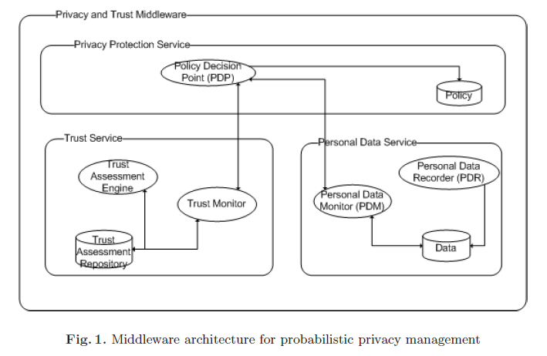
Probabilistic Privacy Policy Enforcement (cont.)

Slide 82
Probabilistic Privacy Policy Enforcement (cont.)
Personal Data Recorder (PDR)
  Protecting users from this kind of aggregation requires complete control of what information has been distributed and to whom.
  Records what data is transmitted to which receivers.
    Example: Consider the situation where a user wanting to stay unidentified has provided his postal code and anonymous e-mail address to a website. Later he also provides age and given name (not the full name) and the anonymous e-mail address. Now, the website is able to combine the data (postal code, age and given name) to identify the anonymous user
      The second interaction with the website should have been blocked, since it enables the website to reveal the user’s identity. The PDR allows the user to view himself through the eyes of the receiving party, and thereby perform aggregation to see whether too much information is provided.

Slide 83
Probabilistic Privacy Policy Enforcement (cont.)
Personal Data Monitor (PDM)
  Computing and assessing policies and behaviour, and to update the personal data recorder with inferred knowledge.
  Determine the likelihood that the personal information distributed to the receiver will also reach other.
    Example: sending an e-mail with a business proposition to a specific employee of a company, it is likely that other employees in that company also will receive the e-mail (e.g. his superior).
    PDM is responsible for inferring other recipients and to include such information in the Personal Information Base.
    Hence, any interaction later on should consider this information when assessing the kind of information to reveal.

Slide 84
Probabilistic Privacy Policy Enforcement (cont.)
Trust Assessment Engine (TAE)
  Calculating trust values of different entities in order to determine their trustworthiness.
  The TAE is focused solely on assessing communicating parties and does not take into account risk willingness, vulnerability and criticality.

Slide 85
Probabilistic Privacy Policy Enforcement (cont.)
Trust Monitor (TM)
  Detecting events that might affect the perceived trustworthiness and the willingness to take risks.
  Calculating and deciding on what is an acceptable trust level, given the circumstances.
  Any computed trust value and feedback received from cooperating entities is stored in the trust assessment repository

Slide 86
Probabilistic Privacy Policy Enforcement (cont.)
Policy Decision Point (PDP)
  The final decision on whether to engage in information exchange and if so; under what conditions.
  Collects the views of both the TM and the PDM and compares their calculations to the policies and requirements found in the policy repository.
  The decision is reported back to the TM and PDM to allow recalculation in case the decision alters the calculated trust values or distribution of personal information

Slide 87
Towards an Approach of Semantic Access Control for Cloud Computing
Luokai Hu, Shi Ying, Xiangyang Jia, and Kai Zhao
CloudCom’09

Slide 88
What did they do?
Analysis existing access control methods and present a new Semantic Access Control Policy Language (SACPL) for describing Access Control Policies (ACPs) in cloud computing environment.
Access Control Oriented Ontology System (ACOOS) is designed as the semantic basis of SACPL.
Ontology-based SACPL language can effectively solve the interoperability issue of distributed ACPs.

Slide 89
Access Control Oriented Ontology System (ACOOS)
Provide the common understandable semantic basis for access control in cloud computing environments.
Divided into four parts, Subject Ontology, Object Ontology, Action Ontology and Attribute Ontology
Web Ontology Language (OWL) is selected as the modeling language of ACOOS.
  Ontology is helpful to construct authorization policy within the scope of whole cloud computing environment based on policy definition elements with determined semantics.
Notes:
All authorization entities (subject, object or action) and their attributes should be understood as the unambiguous meaning in the cloud computing environment.
The action should be determined in according with the policy to ensure that policy administrator of cloud computing environment can define the ACPs an entities which can be understood by other administrators in different applications.

Slide 90
Access Control Oriented Ontology System (ACOOS)
Subject Ontology
  Subject is the entity that has a number of action permissions over object.
    e.g., a user, a user group, an organization, a role, a process, a service
  Attribute of a subject is described by the data property
  The role in subject ontology represents the capability of a subject to implement a task.
  Access permission of resources can be encapsulated in the role.
    If a subject is assigned to a role, it can access the resources indirectly.

Slide 91
Access Control Oriented Ontology System (ACOOS)
Object Ontology
  Object is the entity as receptor of action and is need for protection.
    e.g., data, documents, services and other resources.
  Attribute of an object is described by the data property and object property of OWL with hasObjectDataAttribute and hasObjectAttribute respectively.
  Object group can also be used to define the rule to organize objects.
    Each object group in fact establishes a new object concept, all object individuals of the object concept have object attribute values of the object group.

Slide 92
Access Control Oriented Ontology System (ACOOS)
Action Ontology
  With the cloud computing technology, usually a large number of subjects and objects but only a relatively small number of actions could be found
    e.g., such as reading, writing and execution
  Action also has properties, known as the ActionAttribute, which describes various information of action for authorization and management.
  Action group can be defined with helpful for the definition of rules.
    The definition of action group, nearly the same with the object group, will not repeat it again.

Slide 93
Access Control Oriented Ontology System (ACOOS)
Attribute Ontology
  Attribute types are defined in the attribute ontology, can be used to define the attribute of almost all entities, including the subject, object and action.
  The attribute value of entities is often needed to determine whether meet the Permit conditions or Deny ones.

Slide 94
Semantic Access Control Policy Language (SACPL)
Policy markup language, such as XACML, supports description and management of distributed policies.
The ACP of an object (resource) may be completed by a number of departments even organizations, such as information systems department, human resources and financial department.
The same ACP may be applied to the internal network protection, e-mail system, remote access systems, or a cloud computing platform.
As a result, in cloud computing environment, the issue of interoperability among policies is more important than ever before.

Slide 95
References
NIST (Authors: P. Mell and T. Grance), "The NIST Definition of Cloud Computing (ver. 15)," National Institute of Standards and Technology, Information Technology Laboratory (October 7 2009).
J. McDermott, (2009) "Security Requirements for Virtualization in Cloud Computing," presented at the ACSAC Cloud Security Workshop, Honolulu, Hawaii, USA, 2009.
J. Camp. (2001), “Trust and Risk in Internet Commerce,” MIT Press
T. Ristenpart et al. (2009) “Hey You Get Off My Cloud,” Proceedings of the 16th ACM conference on Computer and communications security, Chicago, Illinois, USA
Security and Privacy in Cloud Computing, Dept. of CS at Johns Hopkins University. www.cs.jhu.edu/~ragib/sp10/cs412
Cloud Security and Privacy: An Enterprise Perspective on Risks and Compliance by Tim Mather and Subra Kumaraswamy
Afraid of outside cloud attacks? You're missing the real threat. http://www.infoworld.com/d/cloud-computing/afraid-outside-cloud-attacks-youre-missing-real-threat-894
Amazon downplays report highlighting vulnerabilities in its cloud service. http://www.computerworld.com/s/article/9140074/Amazon_downplays_report_highlighting_vulnerabilities_in_its_cloud_service
Targeted Attacks Possible in the Cloud, Researchers Warn. http://www.cio.com/article/506136/Targeted_Attacks_Possible_in_the_Cloud_Researchers_Warn
Vulnerability Seen in Amazon's Cloud-Computing by David Talbot. http://www.cs.sunysb.edu/~sion/research/sion2009mitTR.pdf
Cloud Computing Security Considerations by Roger Halbheer and Doug Cavit. January 2010. http://blogs.technet.com/b/rhalbheer/archive/2010/01/30/cloud-security-paper-looking-for-feedback.aspx
Security in Cloud Computing Overview.http://www.halbheer.info/security/2010/01/30/cloud-security-paper-looking-for-feedback
Hey, You, Get Off of My Cloud: Exploring Information Leakage in Third-Party Compute Clouds by T. Ristenpart, E. Tromer, H. Shacham and Stefan Savage. CCS’09
Cloud Computing Security. http://www.exforsys.com/tutorials/cloud-computing/cloud-computing-security.html
Update From Amazon Regarding Friday’s S3 Downtime by Allen Stern. Feb. 16, 2008. http://www.centernetworks.com/amazon-s3-downtime-update
R. Ranchal, B. Bhargava, L.B. Othmane, L. Lilien, A. Kim, M. Kang, “Protection of Identity Information in Cloud Computing without Trusted Third Party,“ Third International Workshop on Dependable Network Computing and Mobile Systems (DNCMS) in conjunction with 29th IEEE Symposium on Reliable Distributed System (SRDS) 2010
P. Angin, B. Bhargava, R. Ranchal, N. Singh, L. Lilien, L.B. Othmane, “A User-Centric Approach for Privacy and Identity Management in Cloud Computing,” 29th IEEE Symposium on Reliable Distributed System (SRDS) 2010
H. Khandelwal, et al., "Cloud Monitoring Framework,” Purdue University. Dec 2010.

Slide 96
Other References for Cloud Security
M. Armbrust, et al., "Above the Clouds: A Berkeley View of Cloud Computing," UC Berkeley Reliable Adaptive Distributed Systems LaboratoryFebruary 10 2009.
Cloud Security Alliance, "Security Guidance for Critical Areas of Focus in Cloud Computing, ver. 2.1," 2009.
M. Jensen, et al., "On Technical Security Issues in Cloud Computing," presented at the 2009 IEEE International Conference on Cloud Computing, Bangalore, India 2009.
P. Mell and T. Grance, "Effectively and Securely Using the Cloud Computing Paradigm," ed: National Institute of Standards and Technology, Information Technology Laboratory, 2009.
N. Santos, et al., "Towards Trusted Cloud Computing," in Usenix 09 Hot Cloud Workshop, San Diego, CA, 2009.
R. G. Lennon, et al., "Best practices in cloud computing: designing for the cloud," presented at the Proceeding of the 24th ACM SIGPLAN conference companion on Object oriented programming systems languages and applications, Orlando, Florida, USA, 2009.
P. Mell and T. Grance, "The NIST Definition of Cloud Computing (ver. 15)," National Institute of Standards and Technology, Information Technology LaboratoryOctober 7 2009.
C. Cachin, et al., "Trusting the cloud," SIGACT News, vol. 40, pp. 81-86, 2009.
J. Heiser and M. Nicolett, "Assessing the Security Risks of Cloud Computing," Gartner 2008.
A. Joch. (2009, June 18) Cloud Computing: Is It Secure Enough? Federal Computer Week.
AWS Amazon EC2: http://aws.amazon.com/ec2/
Amazon CloudWatch: http://aws.amazon.com/cloudwatch/
Iperf: http://iperf.sourceforge.net/

